Slide 1

DR. BABASAHEB AMBEDKAR TECHNOLOGICAL UNIVERSITY
DEPARTMENT OF COMPUTER ENGINEERING
Seminar Topic – Augmented Reality in Education
Under the Guidance of -
Prof. Pramod R. Patil
By -
Gourav Kiran Kolhatkar
(10303320191124510064)

Slide 2
PROBLEM DEFINITION
Hard to provide an adequate level of realism.
Budget limitations of Schools and Colleges.
Availability of equipments or Environment.
Safety hazards.

Slide 3
AUGMENTED REALITY
Augmented Reality is an enhanced version of the real physical world that is achieved through the use of digital visual elements, sound or other sensory simuli delivered via technology.
Information about the environment and its objects is overlaid on the real world. This information can be virtual or real, e.g. seeing other real sensed or measured information

Slide 4
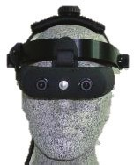
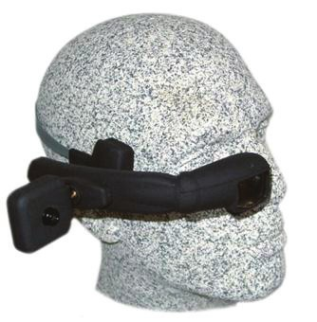
TECHNOLOGIES IN AR
Head Mounted Displays
Head-mounted device is a kind of display which worn on the head or as part of a helmet. It has that has a small display optic in front of one or each eye and a camera module.

Slide 5
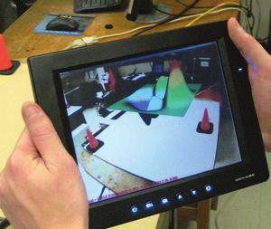
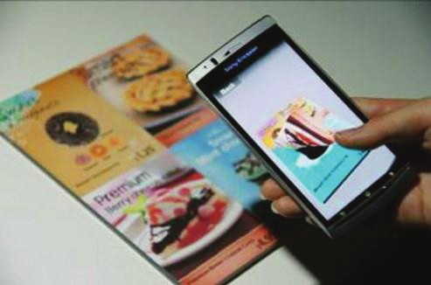
Handheld Displays
Small computing devices with a display that the user can hold in their hands.

Slide 6
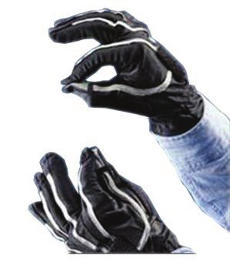
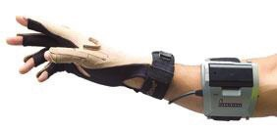
Pinch Gloves
A pinching gesture can be used to grab a virtual object, and provides a reliable and low-cost method of recognizing natural gestures.

Slide 7
AR MOBILE APPLICATION
A general AR Software/App may have the following basic modules in it :
1. Camera :
Camera is like bridge between real world objects and virtual objects.
2. AR SDK :
An augmented reality software development kit, or AR SDK, allows developers to build digital objects that appear to blend into the real world.
3. 3d Models :
These are the 3 dimensional digital/virtual entites or objects which represents real world.

Slide 8
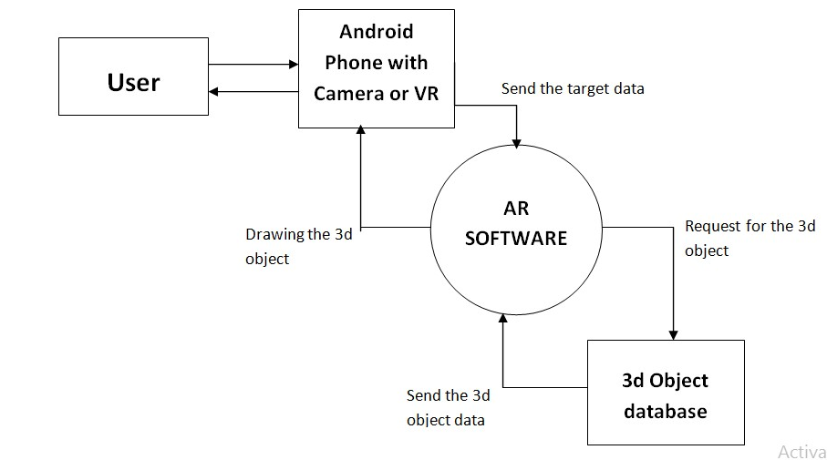

Slide 9
VUFORIA (SIFT ALGORITHM)
Vuforia is a an augmented reality software development kit (SDK) developed by Qualcomm for Image detection and Augmentation (Building-up) 3d models on detected images using Image Processing.
Vuforia uses Scale Invariant Feature Transformation(SIFT) algorithm for image processing to detect and describe local features in image.

Slide 10
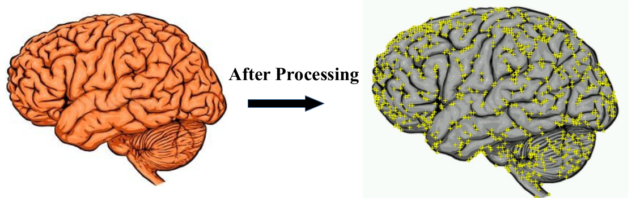

Slide 11
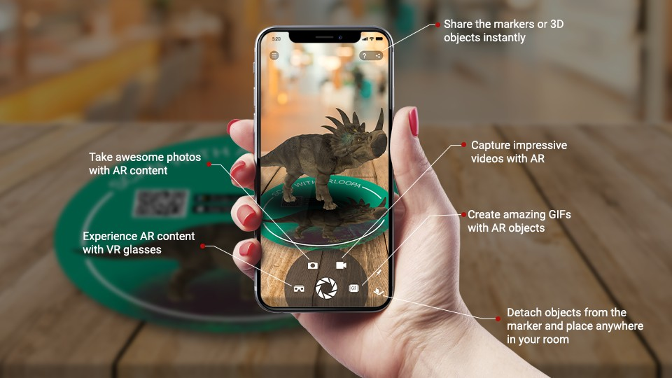
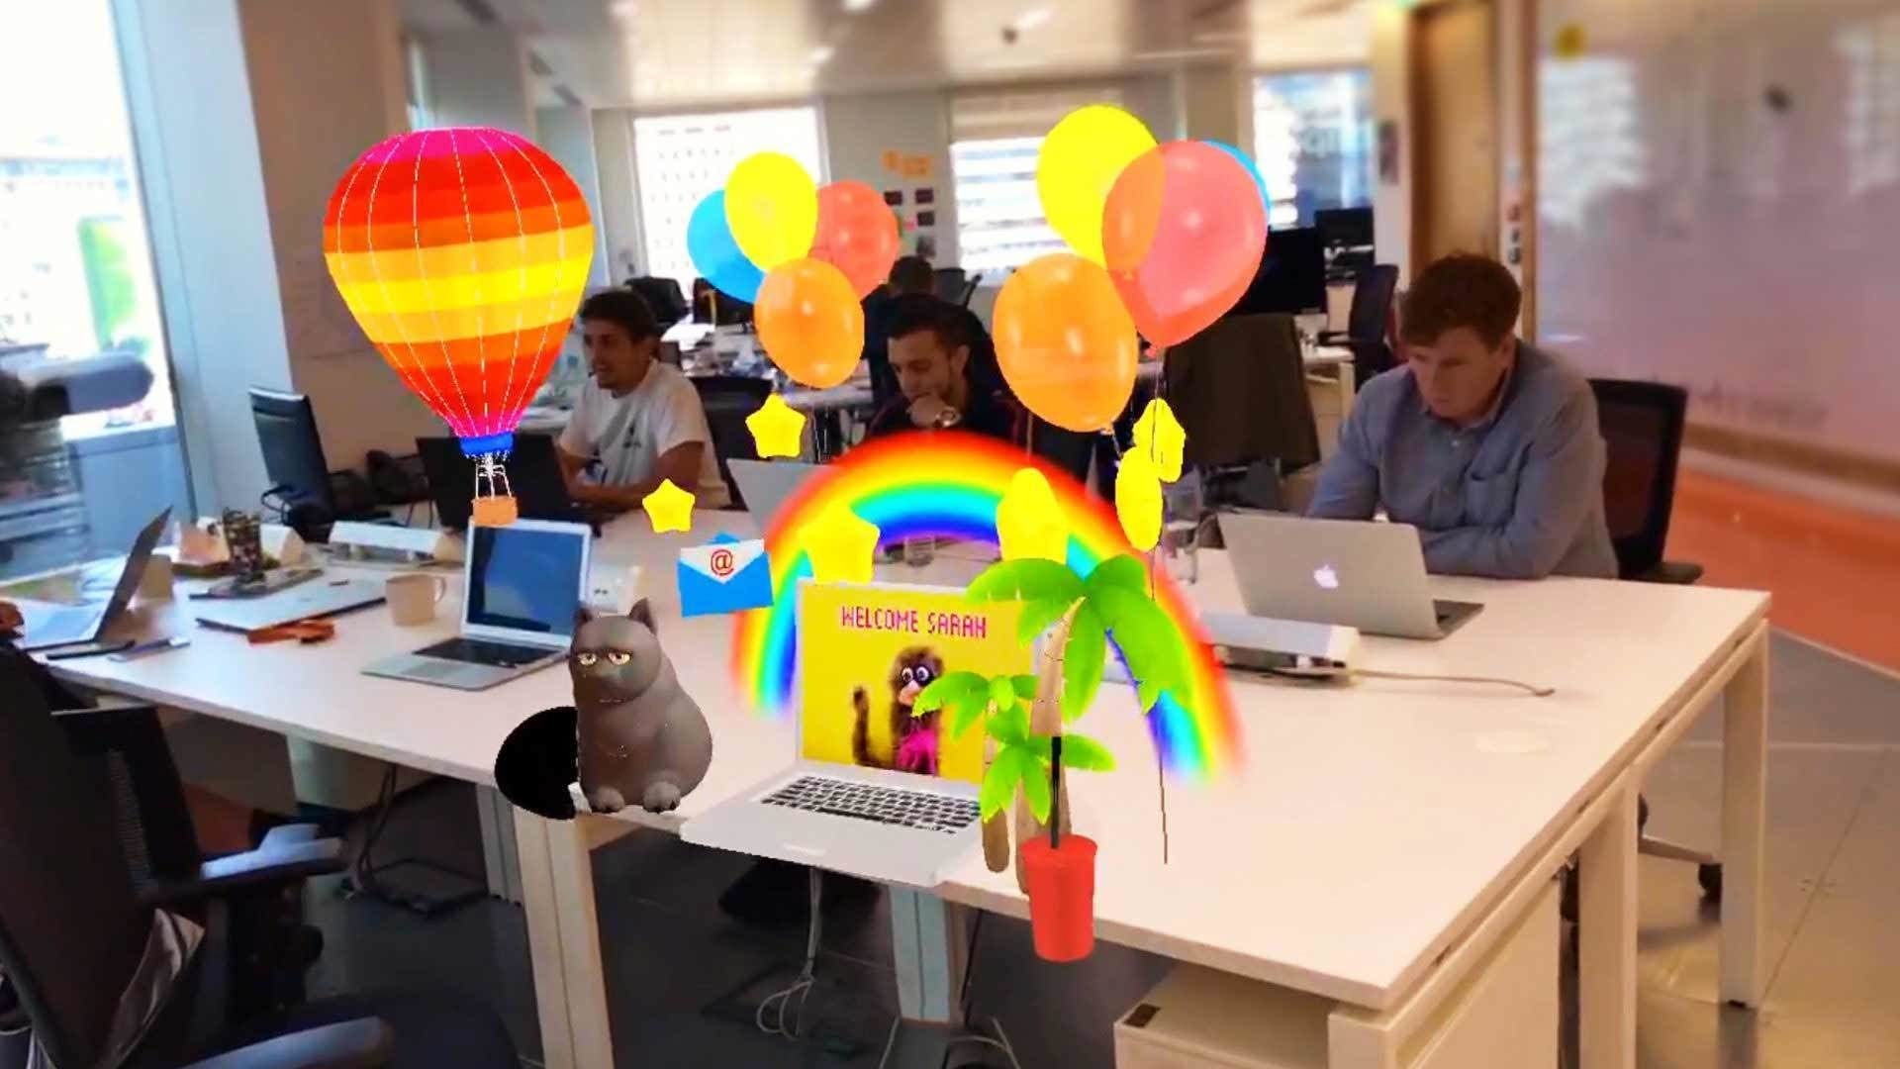
EXAMPLES OF AR IN EDUCATION
Aurasma
Blippar

Slide 12
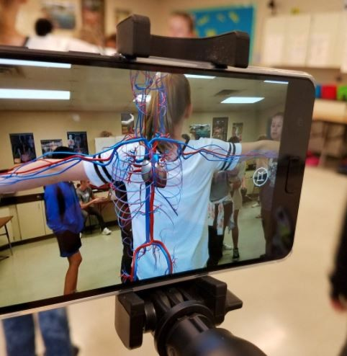
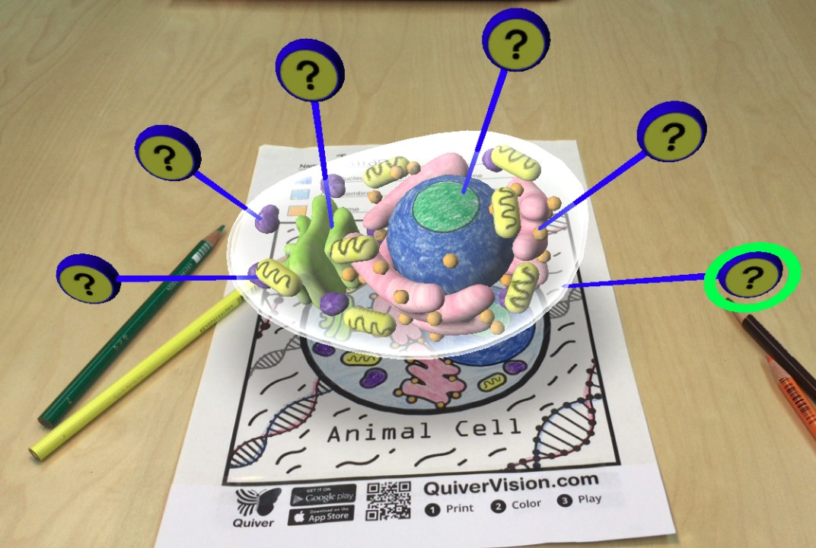
Google Expeditions
Quiver

Slide 13
APPLICATIONS
1. In the Education field : Using traditional textbooks as reference to AR software to visuallize the concepts in 3 dimensions.
2. In Engineering field : For visualizing or for simulation of machines, circuits, experiments or anything which are difficult to demonstrate without actually conducting them one to one.
3. Medical field : To see and understand the Internal Organs and Anatomy realted experiments.

Slide 14
ADVANTAGES AND DISADVANTAGES
Advantages
It reduces line between real world and virtual world.
It enhances perceptions and interactions with the real world.
It can be applied to part of practicals as it makes things memorable and eye catching.
Augmented reality allows adding various information to objects on the screen.

Slide 15
Disadvantages
A need of extra wearable device - Since users may want to feel more authenticity in AR, wearable will be required.
Technical Failure - Technical failures like camera not working, damaged screen or Low battery of mobile phone may cause trouble while using the application.

Slide 16
FUTURE SCOPE
Providing high quality of education has been always in demand now more than ever.
Enrich the learning experience
For educators, technology like this will offer a method of delivering content that makes learning interesting and easier to understand.

Slide 17
THANK YOU

